Slide 1
Welcome!
Thank you for being here.

Slide 2
Agenda
Opening Prayer
Review Last Week’s content/What questions do you have?
Week 5 Exploration- Our Father: The First Three Petitions
Creating Your Domestic Church
Closing Prayer

Slide 3
Opening Prayer
Heavenly Father, We thank you for this opportunity to come together again to learn more about our Catholic faith and of your great love for us. Help us to become more familiar with the words and actions of Jesus in order that we be more able to imitate your son, our Lord. Teach us to confidently live our faith. Help us to pass on our beliefs to our family, friends, and even strangers. We ask this in your name. Amen.

Slide 4
Review of Lesson 4- Our Father: The Summary of the Whole Gospel
The Our Father is the fundamental Christian prayer. It was given to us by Jesus himself. It is the one prayer shared by all Christians.
It was given to us because the disciples would watch Jesus pray. They wanted to imitate him, so they asked him to teach them to pray.
This prayer is a summary of the whole Gospel, the “Good News” that we are children of God.
The most radical revelation of this prayer is Jesus calling God his Father and his invitation for us to do the same. We are called to enter into a familial relationship with God who loves us and desires our love in return. He wishes what is truly best for us.
With this new way to look at our relationship, we need to recognize our dignity as being sons and daughters of God. This should cause greater desire in us to be more like Him. As children tend to want to be like their parents, so should we want to be like God.
We become God’s children through the sacrament of Baptism.
We pray OUR Father (not MY Father) to express our unification in faith with all other believers.
Heaven is not a place; it is a way of being. Heaven is our homeland…not a place to reside among the clouds, but rather a state of being truly united with God in love.

Slide 5
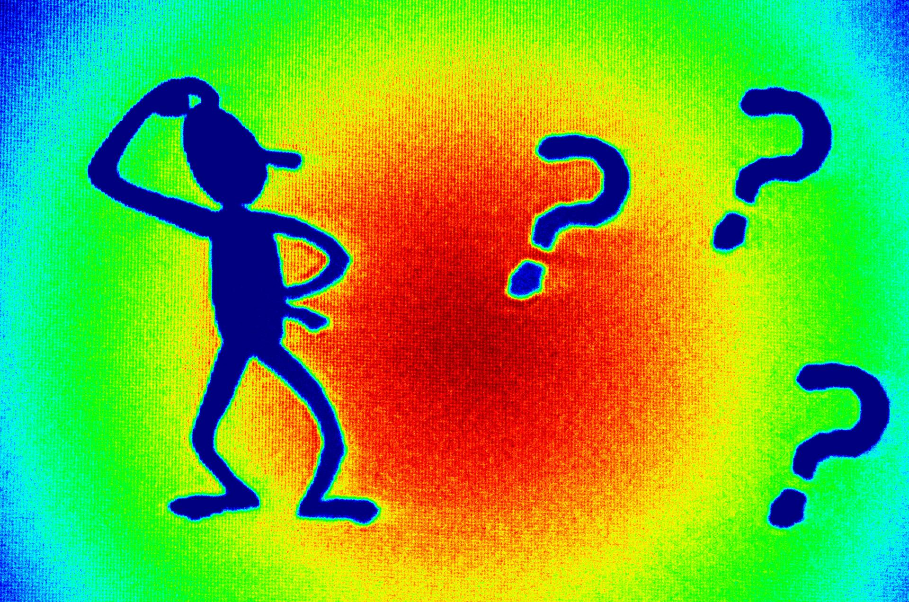
What questions do you have?

Slide 6
Week 5 Exploration: Our Father- The First 3 Petitions
We will look at the manner and order in which we ask someone for things in daily interactions and in prayer. We will investigate if it signifies how we view the other person.
We will look at the opening words of the Our Father to see what it acknowledges.
We will explore the first 3 of the 7 petitions within the Our Father: “Hallowed by Thy name”, “Thy kingdom come”, and “Thy will be done.”

Slide 7
Opening Questions
Do we tend to put ourselves first, or other people?
Do we pray to God only when we need something?

Slide 8
Opening Questions
How can we best glorify God in our lives?
What would the world be like if everyone followed God’s will?

Slide 9
•Hallowed be Thy name
•Thy Kingdom come
•Thy will be done
Notes:
The Our Father’s first three petitions ask to give glory to God! They do not ask in the typical form of a question, but are petitions in that we express what we want to have happen.

Slide 10
“The Lord’s Prayer is the most perfect of prayers.... This prayer not only teaches
us to ask for things, but also in what order we should desire them.” —St. Thomas Aquinas
Notes:
If we search deep in our heart, how many of us treat God like our own personal spiritual vending machine? Our prayers are coins through which we expect God to deliver us the “goods” or “favors” we ask from Him.
Some of us may have experienced a personal relationship where one person was the “taker” and the other person was the “giver.” This is an unhealthy, unbalanced relationship in which the taker’s self-centeredness makes him or her blind to the giver except as a means to fulfill immediate needs.
We must work hard to keep the attitude of a “taker” from creeping into our relationship with God. In the Our Father, Jesus teaches us to orient our prayer so that when we ask at first to give God the glory and praise that is His due, we are moving the focus away from us to God. We are praying to be givers, instead of takers.

Slide 11
The first petition of the Our Father: “Hallowed be thy name.”
We ask to recognize God’s name as holy and therefore treat it in a holy way.
Notes:
We ask to recognize God’s name as holy and therefore treat it in a holy way.
•To be holy means to be set aside in order to conform to God’s purpose.
•By praying that God’s name be made holy in us, we are asking to enter into the eternal plan that God has for the redemption of all humanity.
•Each and every baptized Christian is called to make God’s name holy in his or her life, so that the world can see the face of Jesus in how we live our lives.

Slide 12
God’s “work then, is realized for us and in us only if his name is hallowed by us
and in us” (CCC 2808).
Notes:
God first makes us holy through our Baptism, where we are washed clean of our sin and claimed in the name of Jesus Christ.
This call to holiness continues throughout our lives.
When we live like sons and daughters of God, God’s name is blessed through our lives.
•The opposite is true, too. When we live sinfully, God’s name is blasphemed (to blaspheme is to disrespect that which is holy).
We ask that God’s name be made holy in us so that we can be holy and participate in Jesus saving work in the world!

Slide 13
The second petition of the Our Father: “Thy Kingdom come”. We pray for the fullness of God’s Kingdom.
Notes:
We pray for “the final coming of the reign of God through Christ’s return” (CCC 2818). When Jesus comes in glory at the end of time, He will bring all things under His reign.
•This prayer is for the fullness of the reign of God that is “righteousness, peace, and joy in the holy Spirit” (Romans 14:17).
Praying that Jesus will come again in glory at the end of time does not diminish, but rather strengthens, our commitment to work for the reign of God in our lives and in the world. We are called to work in this world to bring God’s justice and peace.
We are called both to work at furthering the reign of God’s Kingdom through the way we live our lives, as well as to wait for the Kingdom in joyful expectation.
We work and pray, “Thy Kingdom come,” as we wait in joyful hope for the second coming of Jesus Christ and the fullness of His Kingdom.

Slide 14
The third petition of the Our Father: “Thy will be done on earth as it is in Heaven”.
Notes:
What is “God’s will” that we pray will be done on earth as it is in Heaven?
The Catechism of the Catholic Church has the answer: “Our Father ‘desires all men to be saved and to come to the knowledge of the truth.’ … His commandment is ‘that you love one another; even as I have loved you, that you also love one another.’ This commandment summarizes all the others and expresses his entire will” (CCC 2822).

Slide 15
Jesus came to bring salvation to the whole world, and He did so by perfectly
uniting His will to that of His Father’s in Heaven.
Notes:
Jesus’ love for us was so great that in the face of unspeakable betrayal and suffering, and indeed the loss of His very life, He consented to His Father’s plan for our redemption with the total yes of His will.
•As we saw before, Jesus’ anguished prayer to His Father in the Garden of Gethsemane was, “Not my will, but yours be done” (Luke 22:42).
•He knew that He must suffer and die to accomplish His Father’s will.
•He made this great sacrifice out of love for the Father and love for each and every one of us.

Slide 16
When we say yes to the Father, we imitate Christ.
Notes:
When we pray the Lord’s Prayer, we are asking the Father to unite our will to His Son’s will.
We enter into the Father’s mysterious plan that unfolds the salvation that Jesus won for us on the Cross.
•Of course, on our own we are totally incapable of this kind of surrender to the will of God. Only when we are united with Jesus through the power of the Holy Spirit are we able to do God’s will.

Slide 17
Praying “Thy will be done” has a two-fold purpose:
•We ask to be part of the plan that brings God’s will as found in Heaven to the earth.
•We ask to enter into the Kingdom of Heaven ourselves.
Notes:
Jesus tells us, “Not everyone who says to me, ‘Lord, Lord,’ will enter the kingdom of heaven, but only the one who does the will of my Father in heaven” (Matthew 7:21).
Thy Name, Thy Kingdom, and Thy Will, prayed from our hearts, draws us into God’s mysterious and wondrous plan for the salvation of the world. We pray that God’s name will be made holy in our lives, that His Kingdom will rule our lives, and that His will be done in our lives. This prayer unites us to Jesus’ prayer, and now one with Him, God uses us to accomplish the great unfolding of His eternal plan for all mankind.

Slide 18
Discussion/sharing

Slide 19
Discussion questions
What does St. Thomas Aquinas call the Lord’s Prayer and what does he say it teaches us?
What do the opening words of the Our Father acknowledge?
What do the first three petitions of the Our Father express and what do the final four petitions express?
Why do you think that the petitions in the Our Father are given in the order that they are?
Notes:
1. He calls it the most perfect of prayers and that it not only teaches us to ask for things, but also in what order we should desire them.
2. The opening words acknowledge God as our Father and so we worship and adore Him.
3. The first three carry us to glorify the Father, and the final four request our needs in this life for both our body and our spirit.
4. Answers will vary. They teach us to put God first in our lives instead of ourselves.

Slide 20
Discussion questions
What do we ask when we pray, “hallowed be Thy name”?
What does it mean to be holy? What do you think a holy life looks like? When does God first make us holy?
What happens when we live like sons and daughters of God? What happens when we live sinfully?
Notes:
5. We are asking to recognize God’s name as holy and therefore to treat it in a holy way. We are asking to enter into the eternal plan that God has for the redemption of all humanity. 6. To be holy means to be set aside in order to conform to God’s purpose. Answers will vary.
7. Through our Baptism, where we are washed clean of our sin and claimed in the name of Jesus Christ.
8. When we live like sons and daughters of God, God’s name is blessed through our lives. When we live sinfully, God’s name is blasphemed (to blaspheme is to disrespect that which is holy).

Slide 21
Discussion questions
What do we ask when we pray that God’s Kingdom will come?
What is the heartfelt cry of the Church?
What are we called to work for in this world? What are ways that we can do this?
What is the creative tension in which we live?
Notes:
9. We pray for “the final coming of the reign of God through Christ’s return” (CCC 2818). When Jesus comes in glory at the end of time, He will bring all things under His reign.
10. “Maranatha,” which means, “Come, Lord Jesus.”
11. To bring God’s justice and peace. Answers will vary.
12. We live in a creative tension in which, on the one hand, the Kingdom of God is present, and on the other, the fullness of the Kingdom of God will come when Jesus returns to reign in glory.

Slide 22
Discussion questions
What is “God’s will” that we pray will be done on earth as it is in Heaven?
Why did Jesus come to the world?
What was Jesus’ anguished prayer to His Father in the Garden of Gethsemane? What does this prayer show us and how can it serve as an example to us?
What is the twofold purpose when we pray the petition, “Thy will be done”?
Notes:
13. The Catechism tells us: “Our Father ‘desires all men to be saved and to come to the knowledge of the truth.’ … His commandment is ‘that you love one another; even as I have loved you, that you also love one another.’ This commandment summarizes all the others and expresses his entire will” (CCC 2822). 14. Jesus came to bring salvation to the whole world.
15. Jesus’ prayer to His Father is, “Not my will, but yours be done” (Luke 22:42). He shows us how to completely submit our will to the Father, so that we give God our will, even though we know that following His will is difficult. Jesus’ prayer here does not sugarcoat the struggle of submitting our will to God’s. Jesus experiences fear, and He desires to avoid unimaginable suffering. But Jesus gives these feelings to the Father, because He knows that the Father acts out of love to save the human race, and that in the end, Jesus knows He will triumph over suffering, sin, and death through His Resurrection. So too must we follow the Father’s will and die to our own selfish desires so that we can receive new life in Christ. 16. First, we ask to be part of the plan that brings the perfection of God’s will as it is found in Heaven to the earth; and second, we ask to enter into the Kingdom of Heaven ourselves.

Slide 23
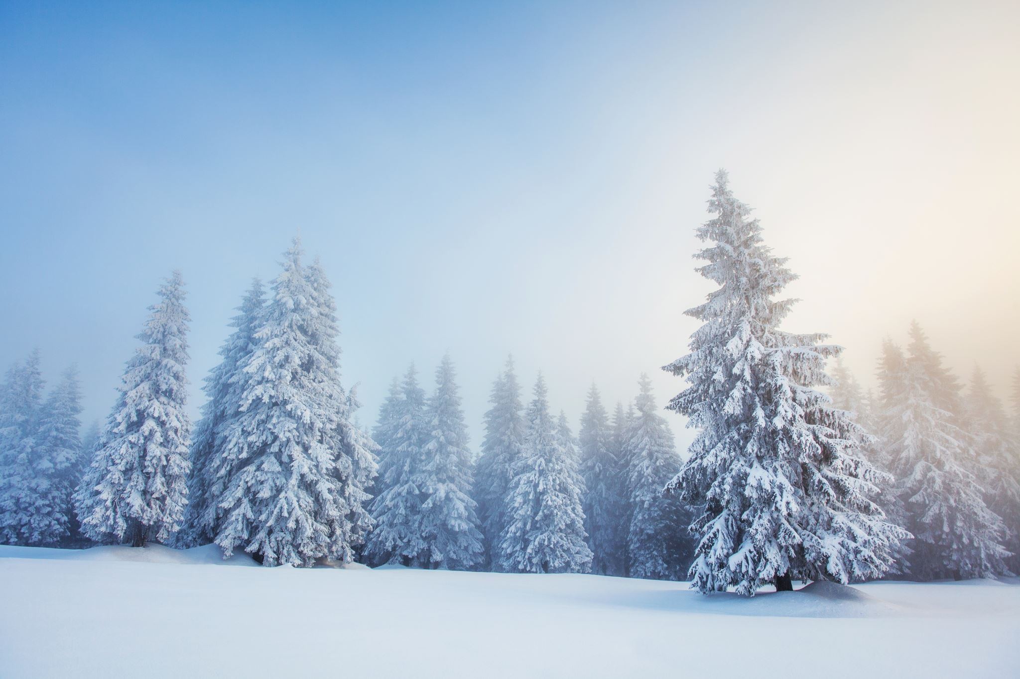
Reminders and Announcements
This is our last class already for 2020. Due to Covid restrictions and our inability to meet in close proximity or intermingled groups, we are not yet having the Family Follow-Up meetings, nor GIFT, the intergenerational class. I will let you know if
anything changes. Otherwise,
our next class is January 10, 2021.
Notes:
Remind parents to put up their new Fridge Page and the Car Conversations hang tag for this month. These can be found in their Parent’s Guide at the beginning of this month’s lesson.
Remind them that they do NOT have to do all the activities in the book. They should choose only the activities they believe will work best for their family. Think quality, not quantity. Also emphasize that this program is first and foremost about their own formation, and secondarily about helping them teach their children. “Put on your own mask first,” as they say! Their children will learn the Faith better from their parents’ witness than through any structured activity.

Slide 24
For the kingdom, the power and the glory are yours, now and forever. Amen. -Doxology of the Our Father
Notes:
Explain that at Mass, we pray the doxology of the Our Father. Doxology comes from the Greek and means “praise.” We praise God the Father when we end with the doxology and repeat in substance the first three petitions of the Our Father: the glorification of the Father’s name, the coming of the Father’s Kingdom, and the power of the Father’s saving will. Only now we are giving thanks for these three petitions as having already happened. That is because we are celebrating the Father’s Kingdom, glory, and power in Heaven! We know that Jesus proclaimed the Father’s Kingdom on earth, and we joyfully acknowledge that earth and Heaven belong to the Kingdom of God. When we pray “Amen” we are saying, “So be it.” We affirm that we believe what we are praying for!

Slide 25
Closing Prayer
Our Father who art in Heaven, hallowed be thy name. Thy kingdom come. Thy will be done on earth, as it is in Heaven. Give us this day our daily bread, and forgive us our trespasses, as we forgive those who trespass against us and lead us not into temptation, but deliver us from evil. For the kingdom, the power and the glory are yours, now and forever.
Amen.

