Slide 1
Welcome!
Thank you for being here.

Slide 2
Agenda
Opening Prayer
Review Last Week’s Content/What questions do you have?
Week 9 Exploration- Expressions of Prayer
Creating Your Domestic Church
Closing Prayer

Slide 3
Opening Prayer
Dear Heavenly Father, I desire to learn how to worship You as You deserve. Help me Lord, to grow into the sort of worshipper that You are seeking, one who worships You in spirit and truth. I pray that my life may be one that honors You in all I say and all I do, in all the circumstances of life, throughout the day and as I drift into sleep at night. Lord, I pray that I may learn to walk in all of Your ways, to serve with all of my being and to learn to love You as You have loved me. Teach me Lord, how to worship You in the beauty of holiness so that I may be one that bows my heart before You in spirit and truth, to Your honor and glory.
In Jesus' name I pray, Amen.

Slide 4
Review of Lesson 8- Prayer to the Virgin Mary
God planned to send His son to the world to save us from our sins. A perfect vessel had to be found from which Jesus would be born. God had to find someone who would willingly cooperate with His Divine plan.
Mary was that person. She had free will to cooperate or not, but God knew she would agree. This is not because God compelled her to agree, but because of God’s nature and His being omnipotent (this incudes place and time) He knew that she would say yes. A special and unique grace was given to Mary because she was to become the Mother of God.
She was conceived in her mother, Anne, free of original sin. God applied to her the Redemption that would be won by her Son’s Death and Resurrection before the moment of her conception. We call this the Immaculate Conception. Mary also remained free of personal sin throughout her life.
The Archangel Gabriel’s announcement to Mary that she was to become the Mother of God is called the Annunciation. Mary responded to Gabriel by saying, “Behold, I am the handmaid of the Lord. May it be done to me according to your word.” (Luke 1:38) Mary’s yes to the Father’s plan is called her fiat. This is the first Christian Prayer.

Slide 5
Review of Lesson 8- Prayer to the Virgin Mary (continued)
If Mary had not said yes to the Father, then Jesus would not have been born. Therefore, the Church calls Mary our mediatrix (another word for intercessor). We see the example of her being an intercessor at the Wedding at Cana and at the foot of the cross.
Mary models for us the grace of total submission to the will of the Father. To be God’s servant we must be willing to do whatever He asks of us. Prayer is one of the ways that we can discover what God is asking of us. When we pursue a relationship with God, we prepare ourselves to respond to His call.
Because of her unique relationship with Jesus, her appeals to Him receive special consideration. We honor Mary as Jesus honors her. We do not adore her. That is reserved for God.

Slide 6
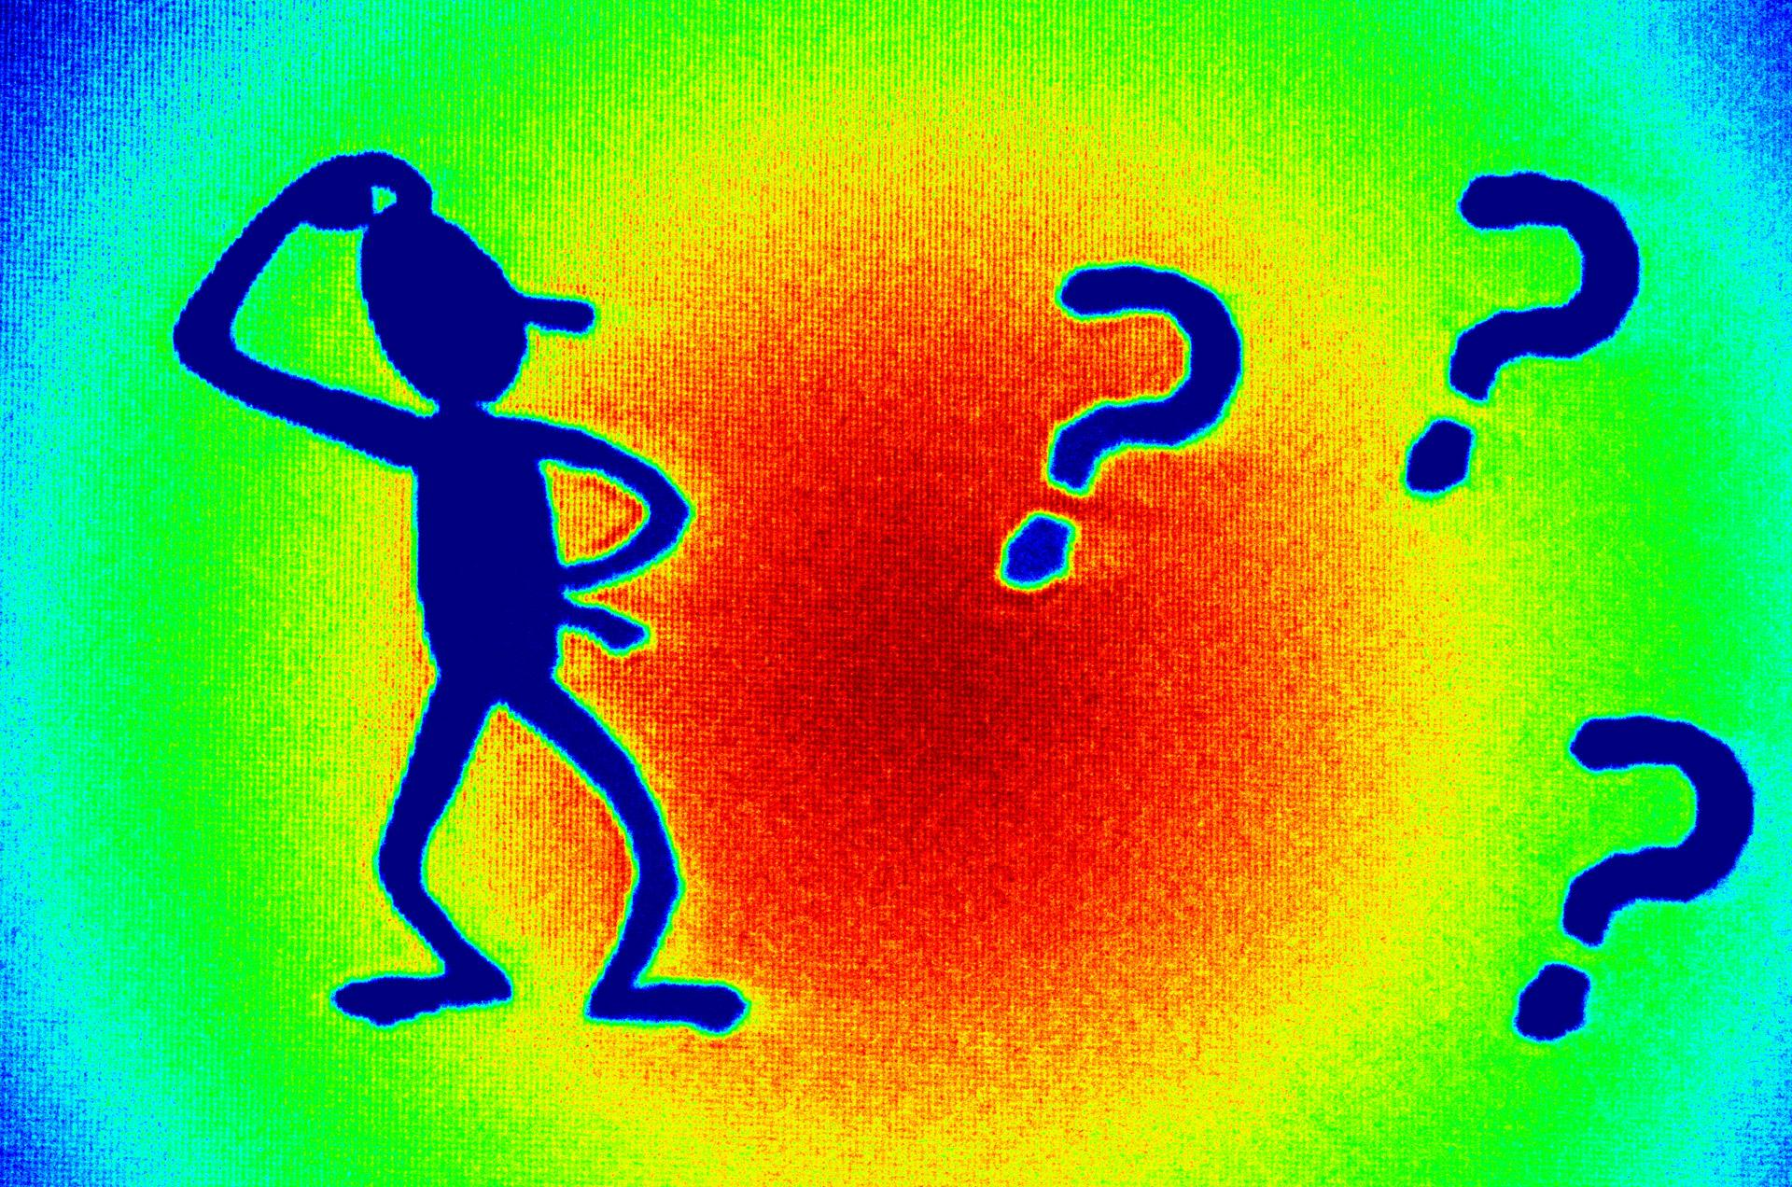
What questions do you have?

Slide 7
We cultivate a loving heart by setting aside specific times of prayer to work on our relationship with God.
Notes:
The Catechism of the Catholic Church explains, “We cannot pray ‘at all times’ if we do not pray at specific times, consciously willing it. These are special times of Christian prayer, both in intensity and duration” (CCC 2697).

Slide 8
The Church gives us three main expressions of prayer:
Vocal prayer
Meditative prayer
Contemplative prayer
Notes:
The Catechism of the Catholic Church explains, “We cannot pray ‘at all times’ if we do not pray at specific times, consciously willing it. These are special times of Christian prayer, both in intensity and duration” (CCC 2697).

Slide 9
Vocal prayer is prayer in which we use our voices to express to God what is in our hearts.
Notes:
Human beings are made up of both body and soul.
It is part of our human nature to express with our bodies what is in our soul.
Jesus understands our human nature both because He is our Creator, and because He shared in our human nature.

Slide 10
Jesus shows us the need to express our prayers out loud.
Notes:
Jesus gave us the Our Father, which is a vocal prayer.
Jesus prayed vocally to the Father many times, such as:
•When He raised Lazarus from the dead.
•In the Garden of Gethsemane.
•From the Cross.

Slide 11
We can pray vocally by ourselves or with others.
Notes:
We can pray traditional prayers such as the Our Father and the Hail Mary.
We can pray spontaneous prayers that come from our hearts.
Vocal prayer is the easiest prayer to pray as a group.

Slide 12
It is not how many prayers we say, but the attitude of our hearts, that pleases God.

Slide 13
In meditative prayer, we use our thoughts and imagination to seek to know God’s will for our lives.
Notes:
Meditation is a quest to learn God’s will in our lives. (CCC 2705)
Meditation engages all of our mental faculties:
•Thoughts
•Imaginations
•Desires
•Emotions
Effective tools or prayers for meditation are:
•Sacred Scripture
•The writings of the saints
•Lectio Divina
•The Rosary
We reflect on these holy writings to see how those words apply to and shape our own lives.

Slide 14
In contemplative prayer we fix our hearts on Jesus. We enter into communion with God through the Holy Spirit during contemplative prayer.
Notes:
It is a free and undeserved gift.
It takes place in silence and is an intense time of prayer.
We fix our gaze on Jesus and renounce our self.
We are purified to love and serve God and others.

Slide 15
Prayer is a decision.
Notes:
It doesn’t matter how busy we are. We must choose to set aside times to pray.
Prayer nourishes our spiritual lives.

Slide 16
Our prayer is an example to our children.
Notes:
The role of parents as “teachers of prayer” cannot be underestimated.
“The Christian family is the first place of education in prayer” (CCC 2685).
Mary and Joseph are the first ones that taught Jesus how to pray.
We should follow their example.
One of the greatest habits that parents give their children is attending the Holy Sacrifice of the Mass each and every Sunday as a family.
We should make this a non-negotiable in family life.
Sunday Mass will bring a lifetime of grace to every member of the family.
The Apostles asked Jesus to teach them to pray after they had seen Him at prayer.
Parents can set that same powerful example in their children's lives.

Slide 17
Discussion/sharing

Slide 18
Discussion questions
What does it mean to say, “We must remember God more often than we draw breath”?
What are some things that you could do to help you remember God in your life?
Why is vocal prayer a necessary expression of prayer?
What makes our prayer pleasing to God?
What question does meditative prayer seek to answer?
Notes:
It means that our actions and thoughts should come from a heart overflowing with the love of God. Actions flowing from a loving heart not only bring us to God, they are a constant prayer. In this way, everything that we do then becomes an offering of prayer to God.
Answers will vary.
3. Because we are made up of both body and soul, to utter with our body what is in our soul is an expression of our human nature. Jesus, both as our Creator God and sharing in our human nature, knew that vocal prayer would be a necessary expression for us in developing a relationship with His Father.
4. The attitude of our hearts. Jesus had strong criticism for those who were constantly praying with many words, but their hearts were far from God. He said, “Well did Isaiah prophesy about you hypocrites, as it is written: ‘This people honors me with their lips, but their hearts are far from me; in vain do they worship me’” (Mark 7:6–7a).
5. Meditation seeks to answer the question “Lord, what do you want me to do?” (CCC 2706).

Slide 19
Discussion questions
What parts of us does meditative prayer engage?
What are some effective tools for meditation?
What do we renounce during contemplation?
How is prayer a decision?
What choices in your life can you make to develop a life of prayer?
Notes:
14. It engages our thoughts, imagination, desires, and emotions. It involves the full spectrum of our mental faculties to give us an increased understanding and faith, and a conversion of heart to desire the things of God. Meditation strengthens our will so that we can say yes to whatever God asks of us.
15. Reading Scripture and the writings of the saints can be effective tools for meditation. We reflect on these holy writings to see how those words apply to and shape our own lives. Above all, Christian prayer meditates on the mysteries of Christ, such as found in Lectio Divina or the Rosary.
16. During contemplation, we fix our gaze so completely on Jesus that we renounce our self—our self-will that stems from an attachment to sin—and are purified to love and serve God and others. The person who enters into this prayer knows that he or she has nothing of his or her own, and is nothing without God. Only the poor and the humble can truly enter into contemplative prayer.
17. No matter how busy we are, no matter how dispirited, we must set aside a part of our lives with the firm intention to pray. Our decision to pray cannot rest on our emotions, our desire to pray, but, rather, our wills. One prayer that we can make to God is that He strengthen our will and desire to pray. Answers will vary.

Slide 20
Creating Your Domestic Church
Let’s take a look at the parent guide and the activity book to see what’s there so you can teach your own children.
Refer to page 309 for a summary of the content.
Go to page 159, then page 183 in the Parent’s Guide to find out more about the activities.
Go to page 112 in the Activity Book to find the materials for the kids to use.

Slide 21
Reminders and Announcements
The next Faith Formation class will take place at Fellowship Hall on March 14th.
We will cover Lesson 10: Praying with Scripture.
Notes:
Remind parents to put up their new Fridge Page and the Car Conversations hang tag for this month. These can be found in their Parent’s Guide at the beginning of this month’s lesson.
Remind them that they do NOT have to do all the activities in the book. They should choose only the activities they believe will work best for their family. Think quality, not quantity. Also emphasize that this program is first and foremost about their own formation, and secondarily about helping them teach their children. “Put on your own mask first,” as they say! Their children will learn the Faith better from their parents’ witness than through any structured activity.

Slide 22
Closing Prayer
Heavenly Father, We thank you for your many blessings. Thank you for the opportunity to once again meet in person for class. Thank you for our health. Thank you for our religious freedom. Thank you for giving us many ways to pray: to talk to you, to listen to you, to commune with you. Help us to be open your voice
and to become the people you want us to be.
We ask this in Jesus’ name, Amen.

