Slide 1
Welcome!
Thank you for being here.

Slide 2
Agenda
Opening Prayer
Review Last Week’s Content/What questions do you have?
Week 11 Exploration- Forms of Prayer
Creating Your Domestic Church
Closing Prayer

Slide 3
Opening Prayer
God of all, You have created all. You love us all. You want the best for all. And you have given us all the gift of prayer to respond back to you. Help us to understand the many ways in which we can glorify you, thank you, and talk to you. Help us to grow in our relationship with you so that we come to desire being with you more and more. In Jesus' name we pray, Amen.

Slide 4
Review of Lesson 10- Praying with Scripture
Scripture is God’s love letter to us. He reveals Himself and His love for us through His word. You can encounter Him while reading it. Because of this, we should approach Scripture with the right mindset.
It is best to set aside a place and time to pray each day. Select a verse or short passage, read it slowly and deliberately, and reread it more than once.
Ask yourself questions as you pray with Scripture such as What does this Scripture passage say to me? How can I apply it to my own life? And if praying with the Gospels, ask What does this Scripture passage tell me about Jesus? How should Jesus’ words change how I live my life?
The Psalms, a collection of prayers, are a good source to use for reading with Scripture. Even Jesus prayed with the psalms. The Psalms are also an important part of the Liturgy of the Hours.
Lectio Divina, a form of praying, is a slow, thoughtful encounter with the Word of God. The steps are: 1- Lectio: Listen to the Word of God spoken in Scripture. 2- Meditatio: Consider how God’s Word applies to our life. 3- Oratio: Respond to God in prayer. 4- Contemplatio: Rest silently in God’s presence and allow Him to speak to our heart. It is easier said than done but can lead to a rich encounter with God.

Slide 5
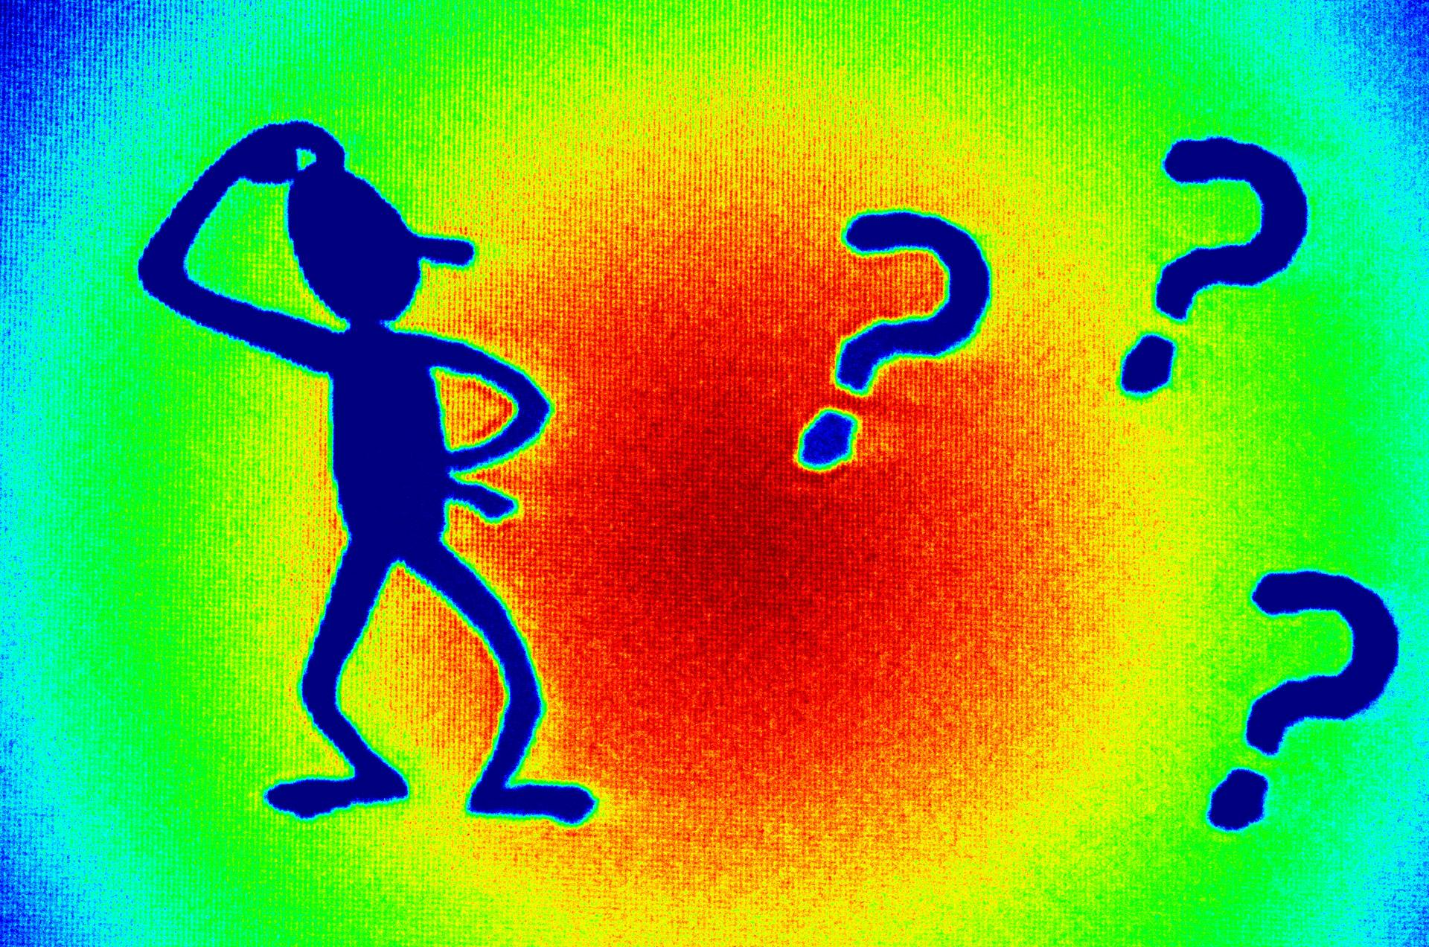
What questions do you have?

Slide 6
Opening Questions
Did you know there were different forms of prayer?
What are some of the kinds of prayer/when do you pray them?

Slide 7
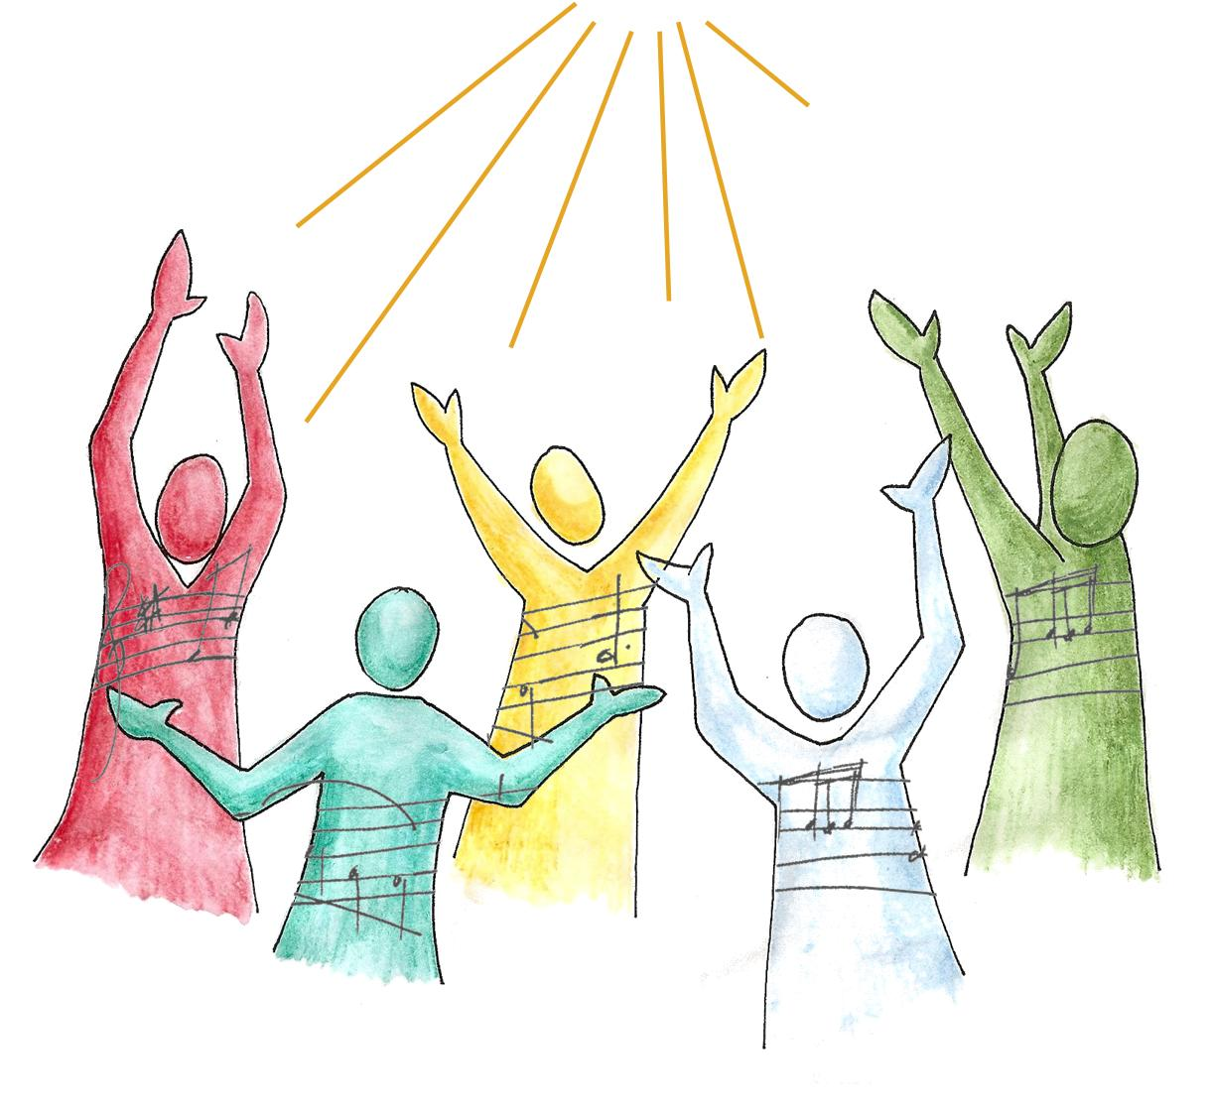
Blessing and Adoration
These are ways to worship God.
Blessing is the basic movement of Christian prayer: an encounter between God and the human person.
God first blesses us and we send our prayers up to Him, blessing Him and asking for His blessing upon us.
Adoration is the attitude of the human person before God (acknowledging that God is his or her creator and that her or she is a creature.)
The Catechism says, “Adoration is homage of the spirit to the “King of Glory,’ respectful silence in the presence of the ‘ever greater’ God” (CCC 2628).
We can only truly receive God’s blessing and respond with blessing in return when our heart’s attitude is that of
adoration.

Slide 8
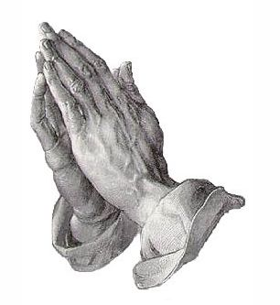
Prayer of Petition
Petition is a form of prayer in which we ask God for good things, including our needs and our wants.
Examples in Scripture expressing the prayer of petition include words such as ask, beseech, plead, invoke, entreat, cry out, even “struggle in prayer” (CCC 2629).
When we petition God for the things that we need, we acknowledge that we are God’s creatures who have sinned and who are in need of His divine assistance. This acknowledgment is an important part of the proper “attitude of the heart” that we must have whenever we pray.
“The first movement of the prayer of petition is asking forgiveness” (CCC 2631). We begin each celebration of Mass by asking forgiveness in the Penitential Rite.
Once we have asked for forgiveness, we can ask Him for the things that we need. The Christian prayer of petition “is centered on the desire and search for the King- dom to come, in keeping with the teaching of Christ” (CCC 2632).But just because we should always pray for the coming of the Kingdom of God, that doesn’t mean that we shouldn’t pray for our daily needs and concerns. God wants to answer our temporal needs, but we ask for them in relationship to the coming of His Kingdom.

Slide 9
Prayer of Intercession
This is also a form of prayer of petition, but instead of focusing on personal needs, it is concerned with the needs of others.
The Catechism defines intercession as “a prayer of petition which leads us to pray as Jesus did. He is the one intercessor with the Father on behalf of all men, especially sinners “ (CCC 2634). When we intercede for others, we participate in this ministry of Christ’s.
To intercede through prayer means to stand between a person and God asking for the things that this person needs. We become a bridge to God, through prayer, for another.

Slide 10
Prayer of Thanksgiving
This is a form of prayer in which we give thanks to God for every gift He has given us.
We can give thanks to God for hearing and answering our prayers even as we request them, because we have faith.
Sometimes it is heard to understand how God answers our prayers. When we encounter difficult circumstances, or His answers were not what we wanted, we can be tempted to think that God did not hear us, or that He doesn’t love us. Only through faith, which does not see and yet believes, can we trust in God’s loving plan in answering our prayers.
When we give thanks to God we are participating in Christ’s thanksgiving, which is expressed most fully in the Eucharist.

Slide 11
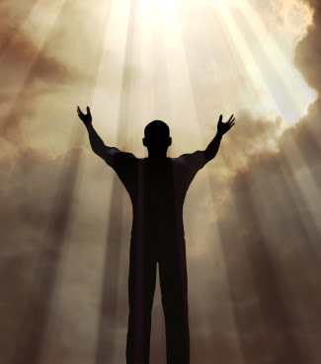
Prayer of Praise
Praise is the form of prayer by which we celebrate God’s goodness. The Catechism explains, “Praise is the form of prayer which recognizes most immediately that God is God. It lauds God for his own sake and gives him glory, quite beyond what he does, but simply because HE IS” (CCC 2639).
When we pray the Gloria, “Glory to God in the highest…” we join with the heavenly choir who forever sings praise to God.
The prayer of praise should be continually in the heart, and on the lips, of God’s children.

Slide 12
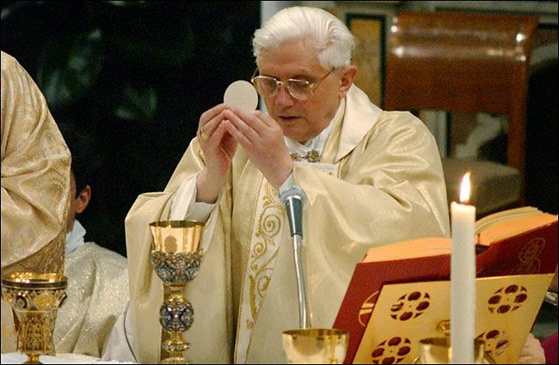
The Eucharist expresses all forms of prayer.
It is a pure offering of thanksgiving and adoration that glorifies God.
It is a sacrifice of praise that satisfies all our needs.
There is no better way of offering our hearts to God than by inviting Jesus into our hearts in the Blessed Sacrament.

Slide 13
Discussion/sharing

Slide 14
Discussion questions
What are the five forms of prayer?
Which one is an encounter between God and human where one bestows upon the other, in light of having the right attitude of the heart?
What form of prayer is when we ask for things for ourselves?
Which kind is when we ask for things for others?

Slide 15
Discussion questions
What do we call the form of prayer where we show our gratitude for all He has given us?
Which kind of prayer do we use to celebrate God’s goodness?
How does the Eucharist express all forms of prayer?

Slide 16
Creating Your Domestic Church
Let’s take a look at the parent guide and the activity book to see what’s there so you can teach your own children.
Refer to page 315 for a summary of the content.
Go to page 203, then page 227 in the Parent’s Guide to find out more about the activities.
Go to page 139 in the Activity Book to find the materials for the kids to use.

Slide 17
Reminders and Announcements
The next Faith Formation class will take place at Fellowship Hall on April 18th.
We will cover Lesson 12: Spiritual Combat.
Notes:
Remind parents to put up their new Fridge Page and the Car Conversations hang tag for this month. These can be found in their Parent’s Guide at the beginning of this month’s lesson.
Remind them that they do NOT have to do all the activities in the book. They should choose only the activities they believe will work best for their family. Think quality, not quantity. Also emphasize that this program is first and foremost about their own formation, and secondarily about helping them teach their children. “Put on your own mask first,” as they say! Their children will learn the Faith better from their parents’ witness than through any structured activity.

Slide 18
Closing Prayer
Dear Father, You are so kind and merciful. You have a love for us that is so great. We are undeserving and we will never understand it. Forgive us for our sinfulness. Help us to become the people you want us to be. Bless those around us who are in need of your healing. Thank you for all the blessings you’ve given us. In Jesus’ name, Amen.

