Slide 1
February Adult Meeting

Slide 2
Agenda
Opening Prayer
Review Lesson 6 & 7/What questions do you have?
Week 8 Exploration- “He Is Not Here; He Has Risen!”
Creating Your Domestic Church
Closing Prayer

Slide 3
Opening Prayer
† Heavenly Father, King of the Universe, be with us today as we gather as your people. Open our minds and our hearts as we listen and learn today. Help us to better understand the words we often pray so that our prayer can be more pure. Guide us in all we do today. We ask this in Jesus’ name. Amen. †

Slide 4
Review of Lessons 6 & 7
Jesus is God. He is fully man and fully Divine.
Jesus performed miracles during His public ministry to show that He was God.
Jesus came to call everyone to the kingdom of God.
God so loved the world that He gave His Son, so that whoever believed in Him would have eternal life.
Baptism forgives Original Sin and makes us adopted children of God.
Jesus made it possible for us to go to Heaven by dying for our sins out of love for us.

Slide 5
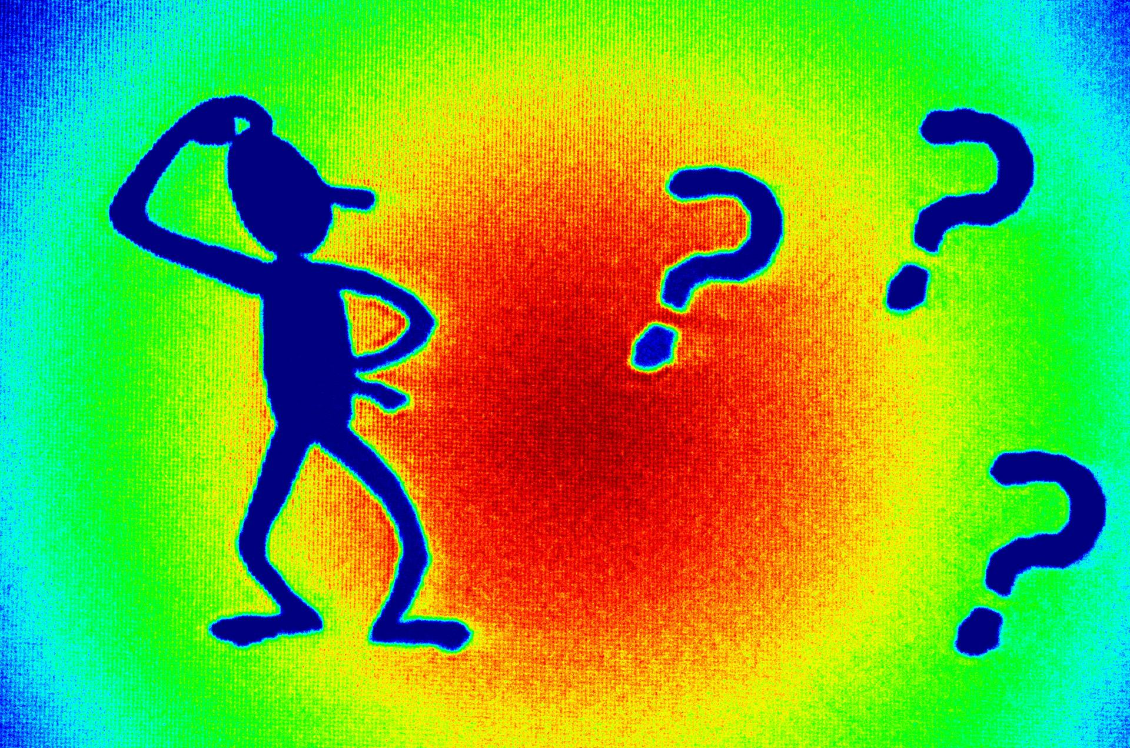
What questions do you have?

Slide 6
“When the Son of Man comes in his glory, and all the angels with him, he will sit upon his glorious throne, and all the nations will be assembled before him. And he will separate them one from another, as a shepherd separates the sheep from the goats” (Matt. 25:31-32).
Notes:
Begin your presentation by reading aloud Matthew 25:31-46.

Slide 7
Opening Questions
What event is Jesus describing in Matt. 25:31-32?
Notes:
The end of the world, or Judgment Day.

Slide 8
Opening Questions
Who or what did Jesus mean by “all the nations”?
Notes:
All of humanity – the Jews and the Gentiles.
Finish reading Matthew 25:33-46.

Slide 9
Opening Questions
Who will inherit the Kingdom of God and why?
Notes:
Those on his right, because they gave Him food when He was hungry, drink when He was thirsty, welcome when He was a stranger, clothing when He was naked, care when He was sick, and company when He was imprisoned.

Slide 10
Opening Questions
How does the King respond when the people do not understand?
Notes:
He explains that whatever we do or fail to do for “the least ones” we do or fail to do for Jesus.

Slide 11
Opening Questions
How should we respond to what Jesus tells us here?
Notes:
By remembering His words in our interactions with everyone and making special efforts to serve others.

Slide 12
Whenever we see someone hungry, thirsty, lonely, or needy, we must respond to that person as if he were Christ.
Notes:
Let’s see what Christ would do for us.
Image of a courtroom
1. Imagine you’ve been charged with a crime – say, the crime of stealing millions of dollars from a bank and losing it all at a casino.
And let’s say you actually did it. You’re guilty. And now you’re in court.
2. And then let’s say that you suddenly realize: the Judge is the same person as your Defense Lawyer!
The guy who’s going to judge you is the same guy who’s working to get you off the hook!
3. And then, even more unbelievably, the same Judge/Defense Lawyer announces to the court: “Also, regarding that money the defendant just lost – that doesn’t need to concern the court any longer. I just paid it all back to the bank out of my own pocket.”
Can you imagine your gratitude to this man, who is doing everything possible to get you freed? Can you imagine how much hope you would have of things ending up all right when the Judge Himself is so invested in your acquittal that He’s representing you and paying off your debt Himself?
That’s what Jesus is to us.
1. He’s the one who made up for our sin with His Death and Resurrection.
2. He’s the one who intercedes on our behalf after the Ascension.
3. He’s the one who will be our Judge at the end of our lives.
So let’s look at the first of these three roles: Jesus as Savior.

Slide 13
Death and Resurrection: Christ our Savior
Notes:
Through His death and resurrection, Christ is our Savior.

Slide 14
Jesus’ Death and Descent to Hell
Jesus bears the weight of our sin on Himself.
When He died, His body hung on the Cross, but His soul went to the realm of the dead.
The Gospel was preached to the dead to free them from exile.
Notes:
Jesus’ Death and Descent to “Hell” (or the place of the dead)[1]. In the Apostle’s Creed we pray, “…was crucified, died and was buried; He descended into hell; on the third day He rose again from the dead;…”We need to recognize that “hell” is translated from the Hebrew “shaol” or the Greek “Hades” meaning the place of the dead, NOT the place where the damned go for the rest of eternity.
As we saw already, Jesus’ mission was to bear the weight of our sin on Himself, and so restore us to God.
Remember that Jesus was fully man. He experienced death just like all other humans. When He died, His human body still hung on the Cross, but His soul went to the realm of the dead just like all those who had died before Him. Once in hell (shaol or Hades) he pointed out to the souls of the just the newly opened door of Heaven.
In St. Peter’s words, “The gospel was preached even to the dead” (I Peter 4:6), so that those who had not seen Christ, but had lived godly lives, might be saved. By preaching the Gospel message of salvation to the just who had died before Him, Christ brought to completion His saving mission.
So Jesus descended into hell in order to preach the Gospel and free His friends – the just – from exile. From the beginning of time until the end of time, the just are partakers in the redeeming work of Christ.
**What happened to Jesus’ soul while He was dead?
**Why?
**Pg. 115, Question 2 (answers on pg 111)
**Pg. 115, Question 3
That’s the part that deals with His death. Now let’s look at His resurrection.

Slide 15
Jesus’ Resurrection
On the third day, Christ rose from the dead.
This is not a made-up story. Each Gospel has a version of what happened.
Even the Pharisees and Romans admitted the tomb was empty.
Paul says there are in his day many living witnesses to the risen Christ. (1 Corinthians 15:6)
His resurrected body was filled with spiritual power, but it was a true human body.
Notes:
Jesus truly died, and truly rose. When Mary of Magdala, other women, and the disciples went to annoint His body, it was gone. He truly rose from the dead and had left His burial tomb.

Slide 16
The Passion, Death, and Resurrection of Jesus Christ is known as The Paschal Mystery
Jesus truly died and truly rose.
The Resurrection is the “crowning truth” of our Faith.
His death and Resurrection is called the Paschal Mystery.
By Baptism, we enter into this Paschal Mystery
Notes:
The Paschal Mystery[2]
The Resurrection is the “crowning truth” of our faith in Christ.
Because Jesus rose from the dead, we rise from the dead as well.
Without the Resurrection, our faith is in vain, as St. Paul says: “If Christ has not been raised, your faith is vain; you are still in your sins. Then those who have fallen asleep in Christ have perished” (1 Cor. 15:17-18).
It is through rising from the dead that Jesus triumphs over sin and death.
Jesus’ death and Resurrection is called the Paschal Mystery. This is another mystery for us to “live in” not to solve. It is beyond what human minds can comprehend.
It is not enough that we believe in the Resurrection, though. We have to enter into the Paschal mystery to get to Heaven.
It is by Baptism that we enter into this Paschal Mystery
And by God’s grace, and our free cooperation, we enter the Paschal Mystery ever more deeply
So that when our bodies die, it will be in union with Christ – and when our bodies rise, it will be to eternal life with God
Paschal comes from the Greek Pascha for Passover. Jesus became the Paschal Lamb.
We call it a mystery because in Jesus Christ, new life can come from death. In Baptism we die a spiritual death and are reborn in the new life of Christ’s Resurrection.
We become heirs to that promise of eternal life in Baptism.
Since we believe that salvation is not a single event but a process, we must cooperate with the grace God offers us through the Sacraments and in receiving God’s grace.
**Questions on page 116. Answers on pg 111 & 112.
What is the “crowning truth” of our Faith?
How would you describe the Paschal Mystery in your own words?
How do we know that believing in the Resurrection isn’t enough to go to heaven?
Listen to this quote from St. Amborse……….What does he mean that we must “cross over from Egypt”?
How do we do that?

Slide 17
Key Points in Our Readings This Month
Jesus descended into hell, the land of the dead, to open the way to Heaven for the just who had died before Him.
Jesus rose from the dead. His defeat over death offers us eternal life.
The Paschal Mystery is the Passion, death, and Resurrection of Jesus Christ.
Salvation is a process that begins with Baptism and continues throughout our lives.

Slide 18
Creating Your Domestic Church
Make sure to read and understand the background reading for Lesson 8, pg. 255.
Read through and pick 2 of the 4 activities, pg. 137. There is not a storybook activity this lesson.
Don’t forget about other components
Car Conversations, pg. 135
Fridge Page, pg. 133
Saint of the Month: St. Brigid of Ireland, pg. 159
Month in Review: pg. 162
Notes:
Instead of a Community Meeting, this month the program asks that we complete a service project. Any ideas? Garage sale help.

Slide 19
Closing Prayer
† Dear Lord Jesus Christ, we thank you for Your love, which is so great that You left heaven and all Your glory in order to die and rise for us. Please help us to love all people and to do to them what we would want to do for You. Help us to be Your hands and feet. We ask this in your name. Amen. †

